Slide 1
Secure data hiding in image using steganography
CAPSTONE PROJECT
Presented By:
Student Name : Rehan
College Name & Department : Pranveer Singh Institute of Technology Kanpur

Slide 2
OUTLINE
Problem Statement
Technology used
Wow factor
End users
Result
Conclusion
Git-hub Link
Future scope

Slide 3
Problem Statement
Data hiding in images using steganography embeds secret information within an image without visibly altering it, enabling covert communication. Unlike cryptography, which encrypts data, steganography conceals the existence of the hidden message. The challenge is to maintain image quality while embedding significant data, balancing capacity and imperceptibility.

Slide 4
Technology used
Steganography libraries and platforms include Python's cv2, string, and os libraries for image processing and data manipulation, along with steganography and ImageCipher for encoding messages in images. C++'s ImageSteganography library and Go's steganography package support LSB steganography. Tools like Steghide enable data hiding in image and audio files.

Slide 5
Wow factors
The wow factor of this steganography project is its seamless integration of Python's cv2, string, and os libraries, enabling robust image processing and data manipulation. Unlike other tools, it offers a unique blend of simplicity and efficiency, making it accessible for both beginners and advanced users. This combination allows for embedding large amounts of data without compromising image quality, setting it apart from traditional steganography methods.

Slide 6
End users
The end users of this steganography project include security professionals, developers, researchers, privacy enthusiasts, and government agencies who need to securely transmit sensitive information without detection.

Slide 7
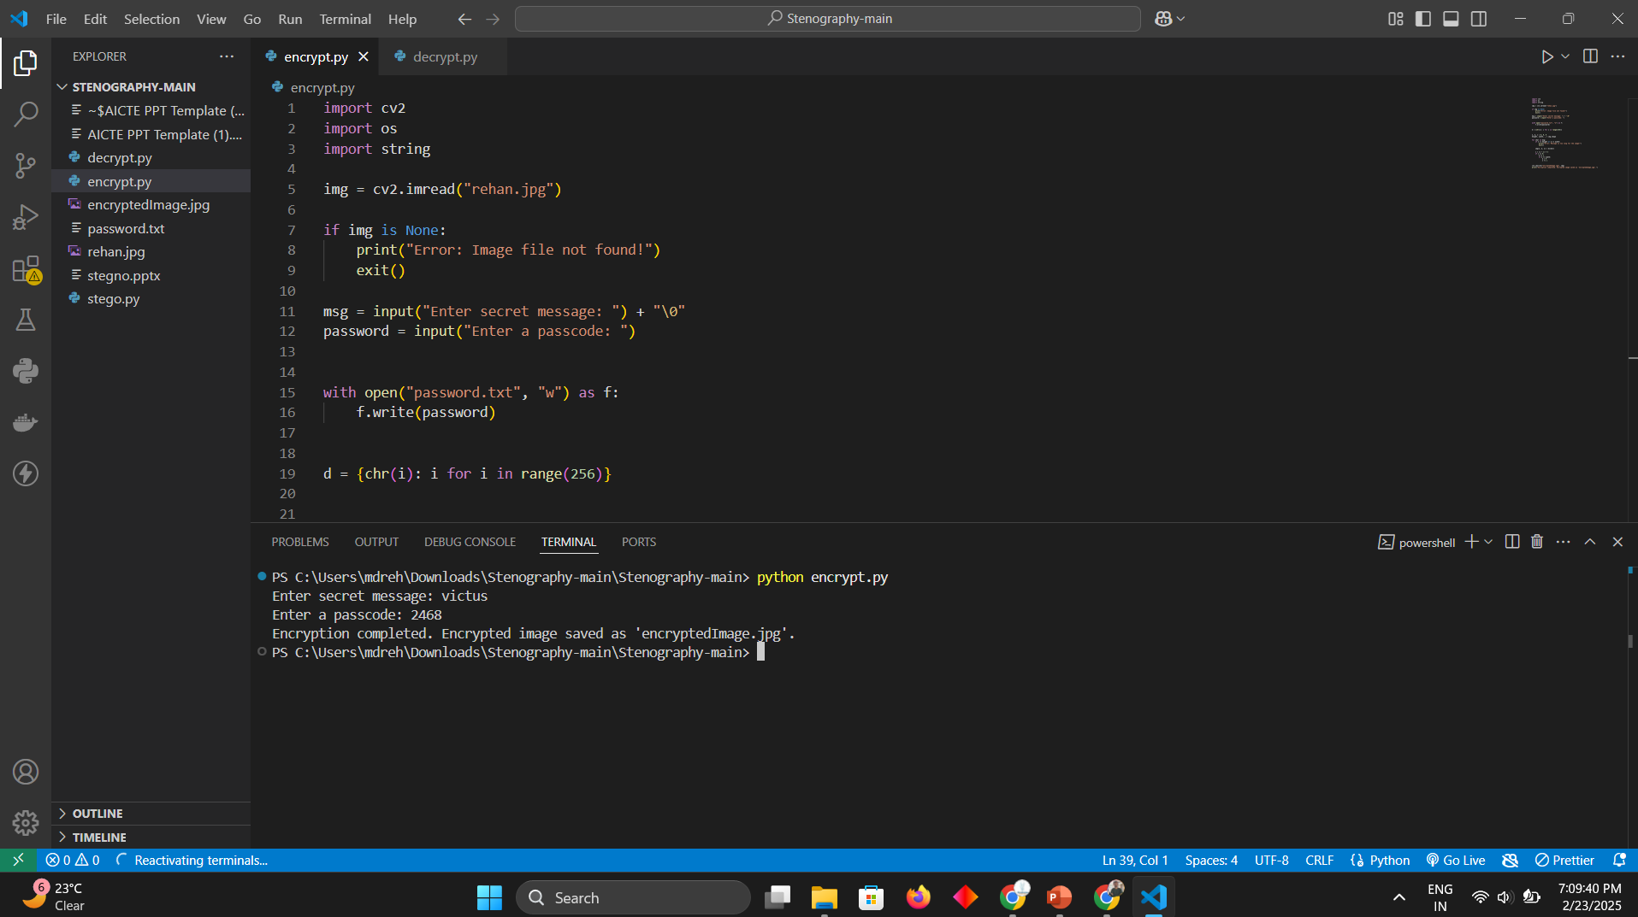
Results

Slide 8
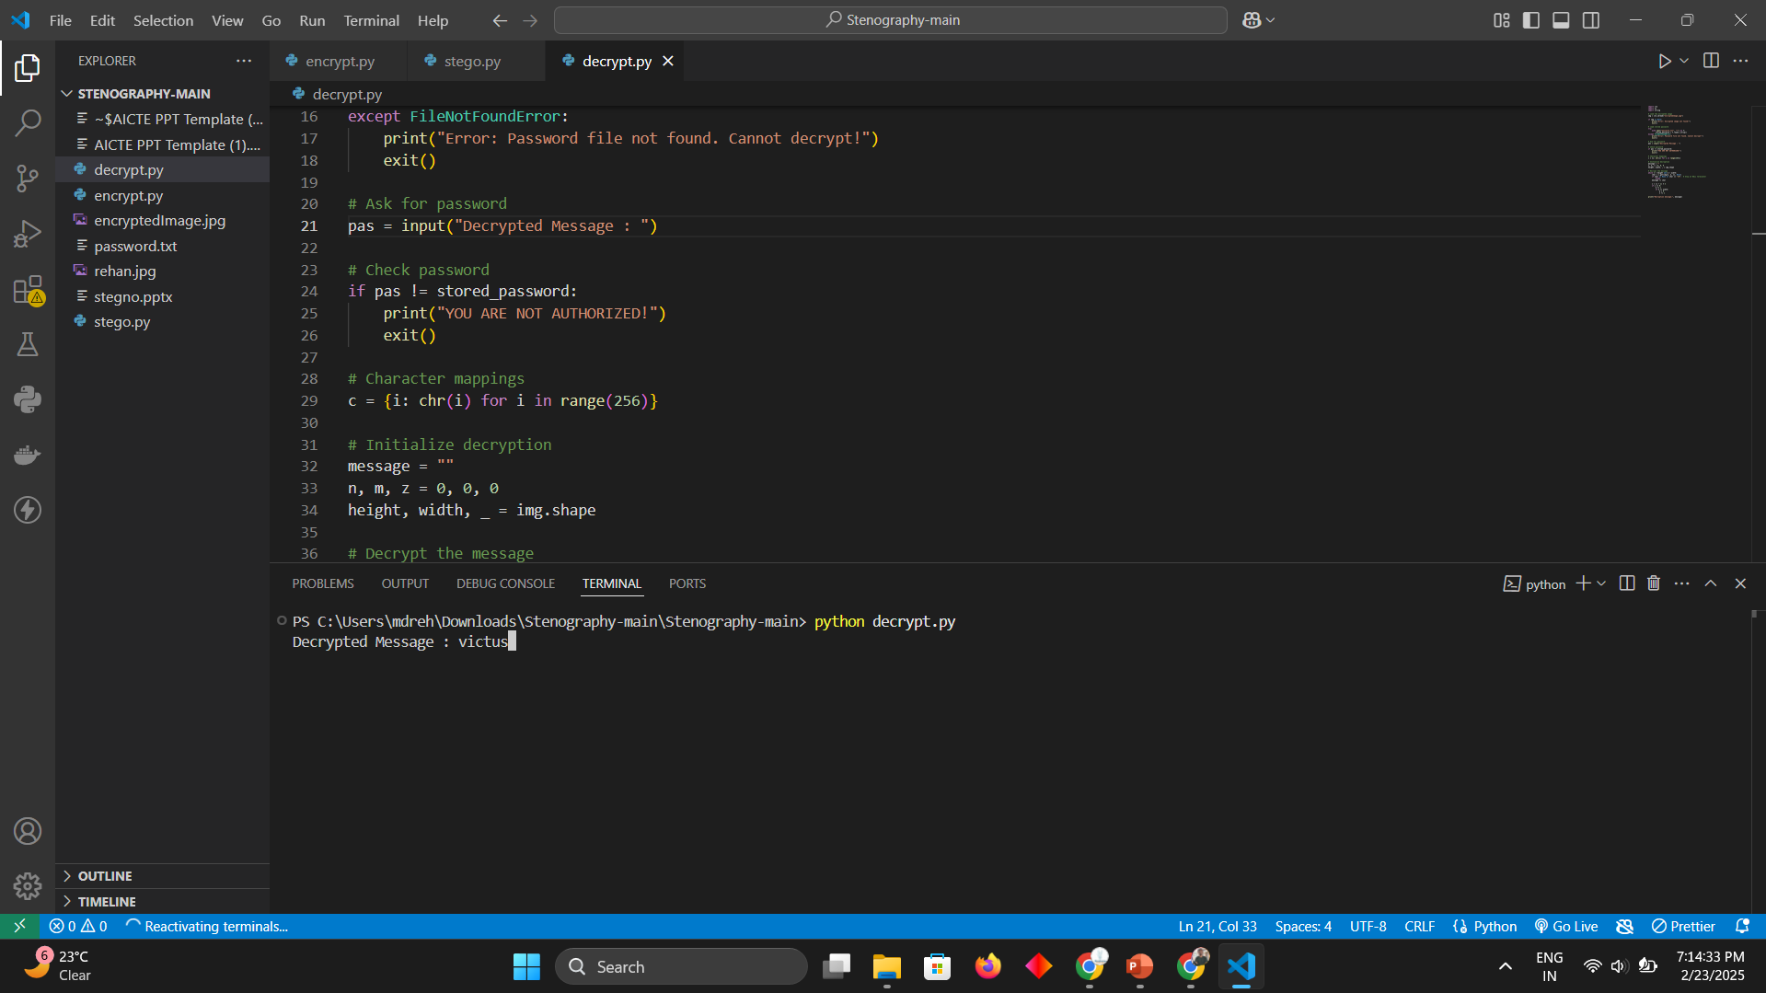

Slide 9
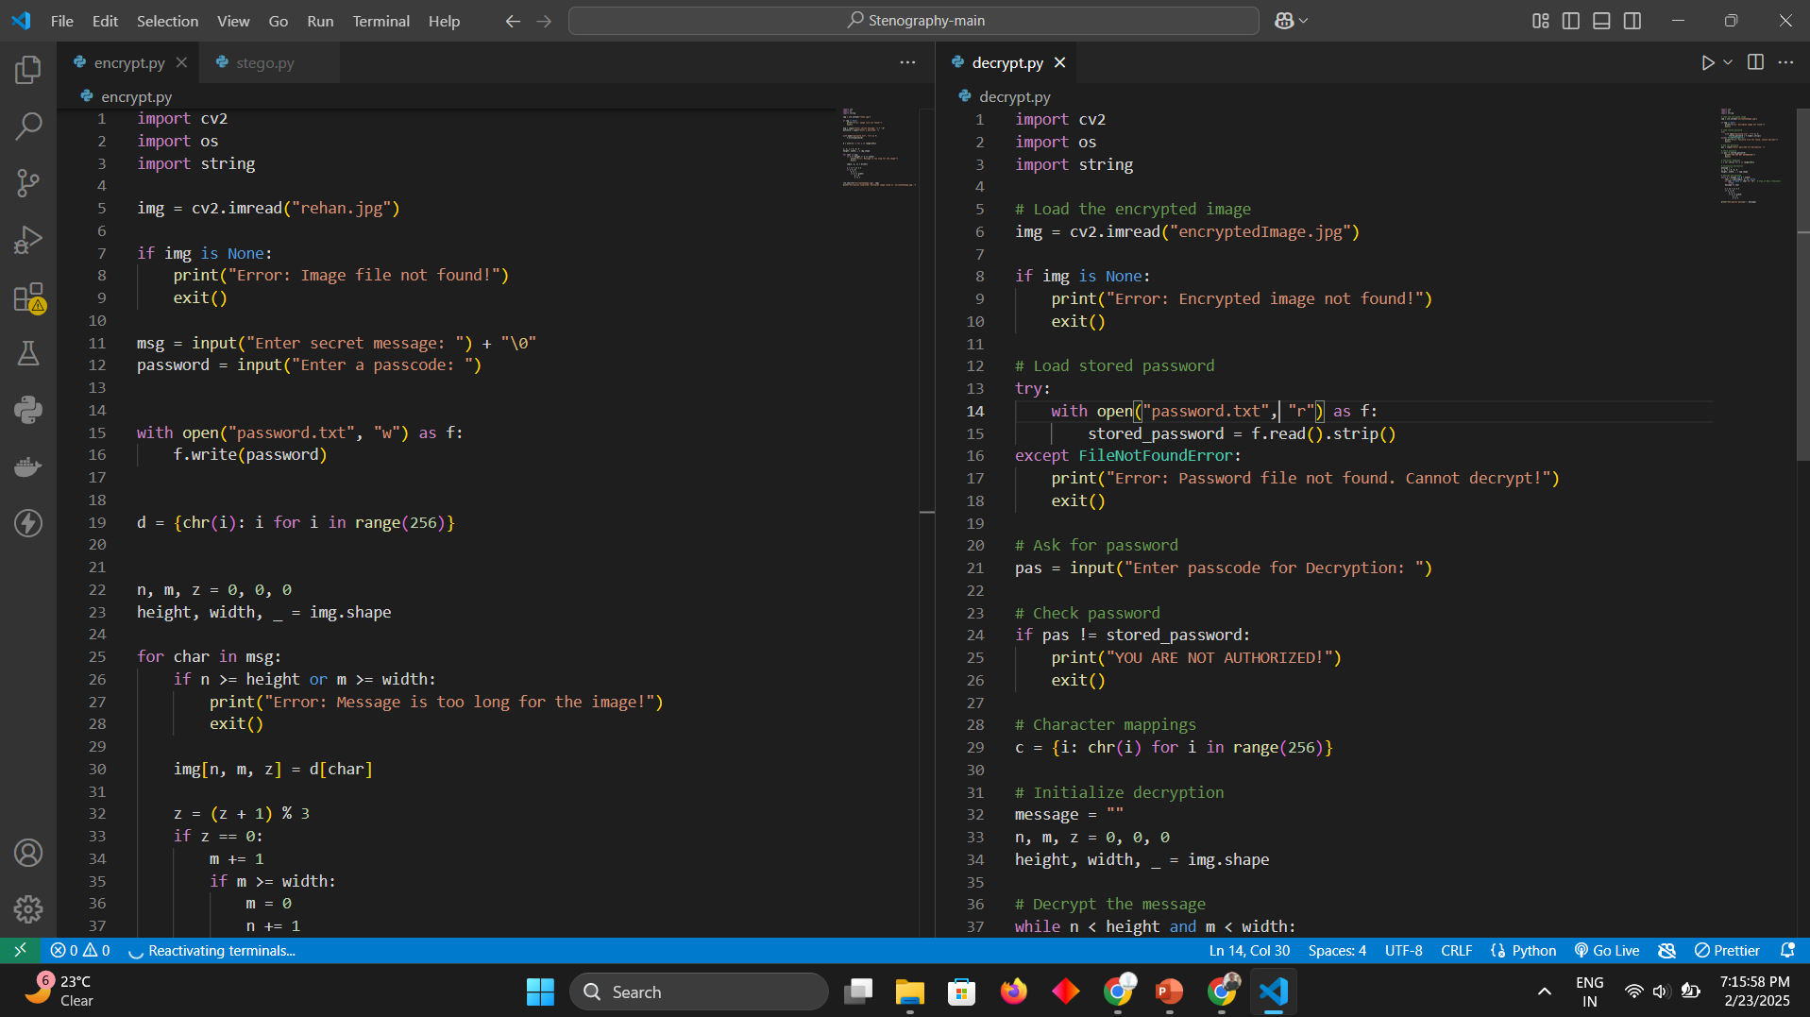

Slide 10
Conclusion
This steganography project uses Python's cv2, string, and os libraries to embed secret data in images efficiently. Its unique combination of simplicity and robustness makes it ideal for secure, covert communication, benefiting security professionals, developers, researchers, privacy enthusiasts, and government agencies.

Slide 11
GitHub Link
https://github.com/rehan-thecs

Slide 12
Future scope(optional)
The future scope of this steganography project includes enhancing security with advanced encryption, supporting multiple image and multimedia formats, developing a user-friendly interface, optimizing for larger datasets, enabling real-time applications, and integrating AI for improved techniques.

Slide 13
THANK YOU

